Slide 1

Intro to Wi-Fi Hacking
Wi-Fi Attacks & Password Cracking with Microcontrollers
By Kody Kinzie, Security Researcher at Varonis

Slide 2
Welcome to Null Space Labs
LA’s #1 Hackerspace, home to many projects like this and people who like to hack, build, and organize community events.
Thanks for coming, your tickets help support this space!
Check out the open nights on Tuesday, get a tour and meet people in LA who like the same things as you.
Become a member and support the community. Make your own class, project or event to get people excited about hacking, programming, and art.

Slide 3
Who am I?
I’m Kody, a security researcher for Varonis with an interest in Wi-Fi security and microcontrollers.
I work with other hackers on wireless security, open source research, and low-cost prototypes.
I’m a keyholder at Null Space Labs, member of the hacker and maker community.
I’m the host and creator of a YouTube show called Cyber Weapons Lab for Null Byte, produced for WonderHowTo.com (soon to hit 500k subs!)
I teach beginners and professionals about how to get started hacking, conduct investigations, and how to prevent attacks.
Follow me on Twitter - @KodyKinzie , Github: Skickar

Slide 4
What are we doing today:
Explore how Wi-Fi works under normal conditions
Outline what kind of attacks exist against Wi-Fi
Learn about deauthentication attacks
Learn how WPA2 password cracking works
Understand the difference between Raspberry Pi & Arduino-programmed microcontrollers
Learn how microcontrollers can attack over Wi-Fi
Use your ESP8266 microcontroller to scan and target devices on a network
Clone a Wi-Fi network, create a fake Wi-Fi network
Attack our reactive targets with deauthentication attacks and watch a demonstration of password cracking

Slide 5
Is This Legal? Can I Get In Trouble
It is illegal, and a crime, to attack a network you do not have permission to test
The attack we will learn today is easy to detect by any IT person. If you do this to an important network, you will likely be caught
This is a big flaw in Wi-Fi that isn’t fixed yet. You can cause a lot of damage by running this tool without paying attention
You NEVER know what a network is connected to. Attacking an unknown network can cause serious damage and consequences you don’t intend
We are providing safe and legal targets today, do not attack any devices or networks out of scope.
If you abuse this, you do so ignoring all these warnings

Slide 6
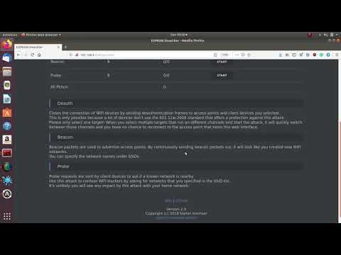
Quick Demo:

Slide 7

What is Wi-Fi?
Wi-Fi connects devices together much like ethernet, but has a few important differences. It uses radio signals sent from a transmitter to a receiver instead of wires.

Slide 8
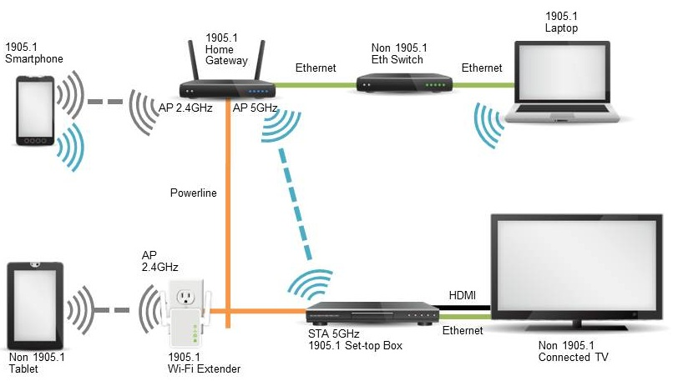
Wi-Fi is riskier: Anyone in range can try to join

Slide 9
Types of Wi-Fi Network Security
Open - No Password, no encryption. Anyone can see what websites you are requesting. All HTTP traffic is plain text. Insecure.
WEP - Outdated, easy to crack. Almost worse than open. Takes 15 minutes to crack.
WPA - Better encryption, not used as often
WPA2 - Modern Wi-Fi, vulnerable to brute force or workarounds
WPA3 - Just came out - Optional standard, so lots of holes. Dragonblood is the first exploit discovered

Slide 10

While Wi-Fi is convenient, it had disadvantages
Wi-Fi is half-duplex while ethernet is full duplex - one device talks at a time
Routers have convenience features that break security
The encryption protecting it is vulnerable if you use weak passwords
Anyone can jam a device from connecting to a Wi-Fi network
Devices can lie or pretend to be someone else on the network

Slide 11
What can “Wi-Fi Hacking” mean?
Denying a single device service to any network (device targeted protocol jamming)
Denying a network from establishing connections to any devices (network targeted protocol jamming)
Disabling all Wi-Fi networks within range (indiscriminate protocol jamming)
Retrieving the network password by capturing a WPA handshake and attempting to crack it (WPA2 password cracking)
WPS Setup Pin Attacks (WPS Pixie)
Eavesdropping on Wi-Fi traffic
Jamming and fake network combo
Tracking devices between locations by Wi-Fi signals

Slide 12
Some Scenarios:
Brute forcing a weak password
Deauthing a Wi-Fi security camera
Disabling all nearby Wi-Fi connections
Disabling only a single connection
Forcing a device to connect to a malicious network (herding)
Disabling Smart Home devices

Slide 13
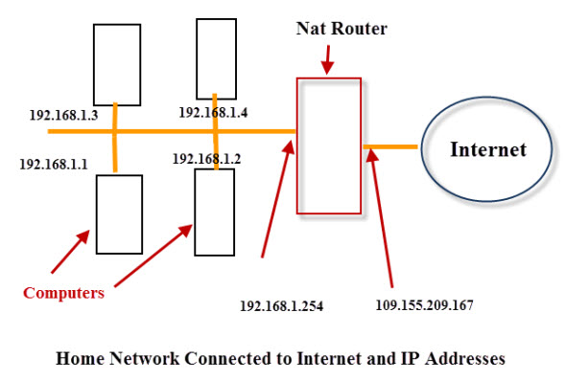
How does Wi-Fi work normally?
An IP address is set by the network you connect to, like a parking space
The router assigns every device that connects to the network a unique IP
Two kinds of IP addresses, internal and external
Without the password, you can’t see the IP address of devices on encrypted Wi-Fi

Slide 14
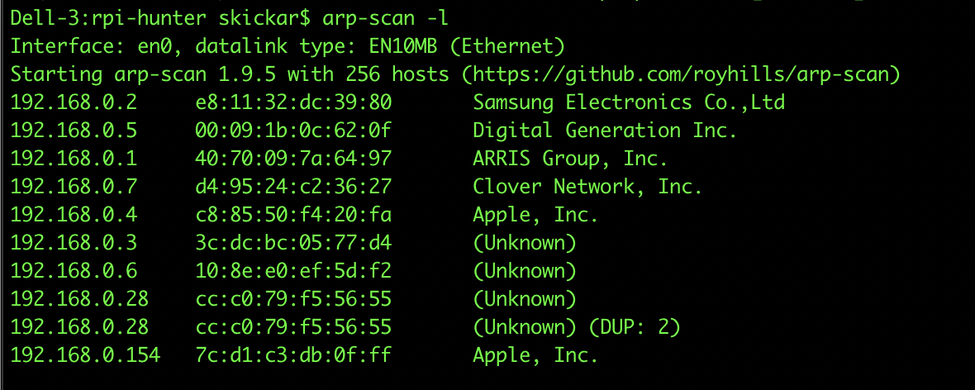
What happens when you join a Wi-Fi network?
When you join a Wi-Fi network, your device’s MAC gets paired with an IP address
The router uses this to deliver traffic from your device to the internet and back

Slide 15
Your IP may change, but your MAC will not
You can think of this like parking a car in parking space, it may change depending on who gets there first and which are available
The exception is MAC address randomization, which happens when your device is not connected to the network.

Slide 16
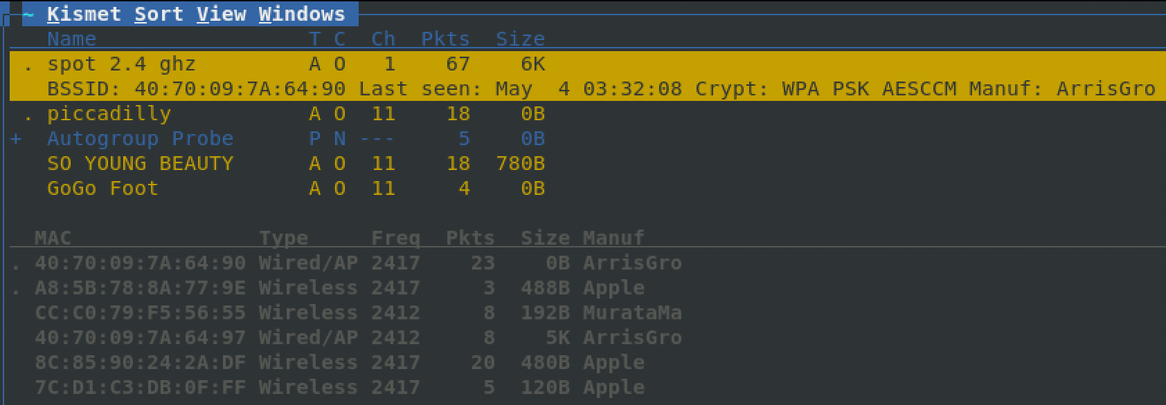
How do we identify devices like phones and laptops?
Your MAC is set by your device and rarely changes, like a car’s license plate
Every Wi-Fi device has a MAC address, any outsider can see it
Devices have to use their MAC address to transmit on a Wi-Fi network

Slide 17
Types of Attacks: Inside or Outside The Network
Attacks take place either:
Outside the network, when the attacker doesn't know the password and can’t see the encrypted contents of the communication, or
Inside the network, where the attacker knows the password and can see the contents of at least some of the traffic.
Takeaway: It is much worse for an attacker to be inside your network.

Slide 18
What Can You Do With the Password?
Pretend to be the router and hijack ALL network traffic
Watch what people are doing
Redirect requests to any website to a password stealing version
Inject things into the browser like keyloggers
Scan devices on the network and connect to them!

Slide 19
What Can You See Without the Password?
How many devices are out there, who made them, and which network they are connected to
The real MAC address of any device, so you can track it when it comes and goes
Which devices are sending data or being used and which are not
Kick anyone or any device off the network
Because this is where everyone starts, we’ll focus on these sorts of attacks today.

Slide 20
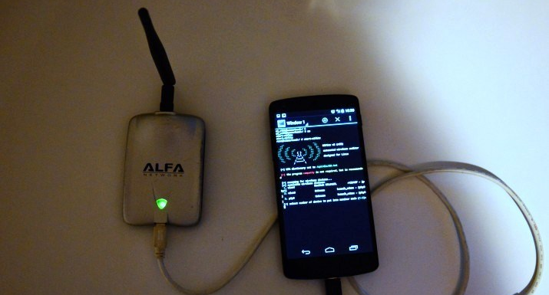
Let’s talk attacks!
There are three main categories we will cover today:
WPS Setup pin attacks
WPA handshake cracking
Social engineering & phishing

Slide 21
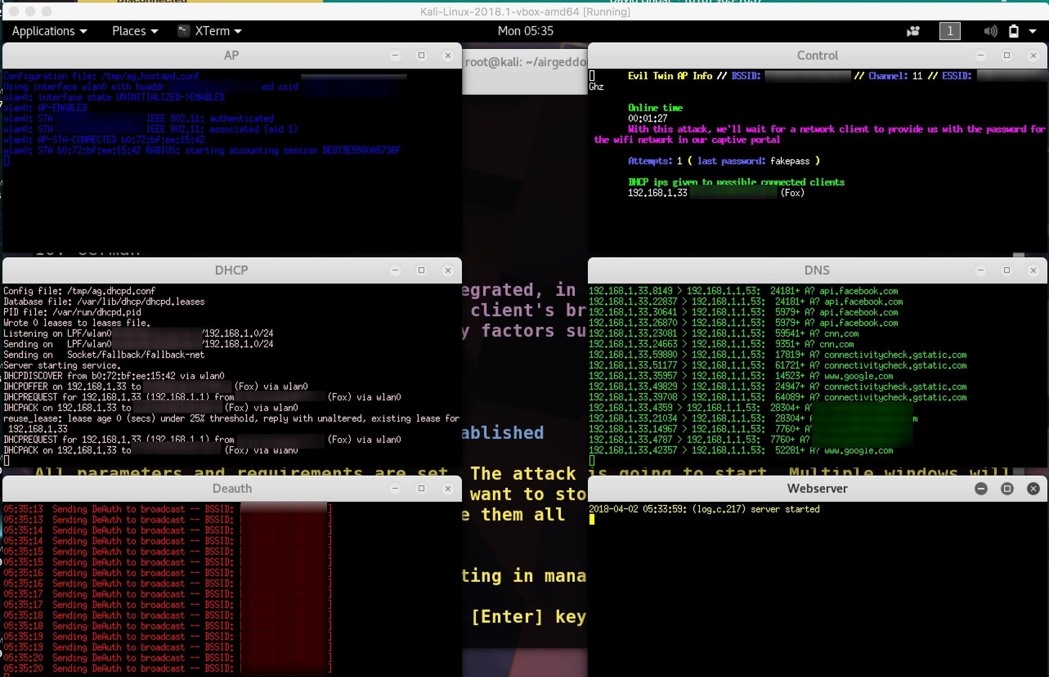
Social Engineering attacks rely on user error
In a social engineering attack, we create an “evil” network for someone to join.

Slide 22
What does social engineering look like?
Copy the name of the target Wi-Fi network, and make a fake network with no password
Jam the real Wi-Fi network, and create a fake router update page asking for the password on the open network
When the user cannot connect, they see the fake network with the same name as their usual network.
The user connects and sees the page explaining an update is in progress. They enter the password.
The attacker gets the password

Slide 23
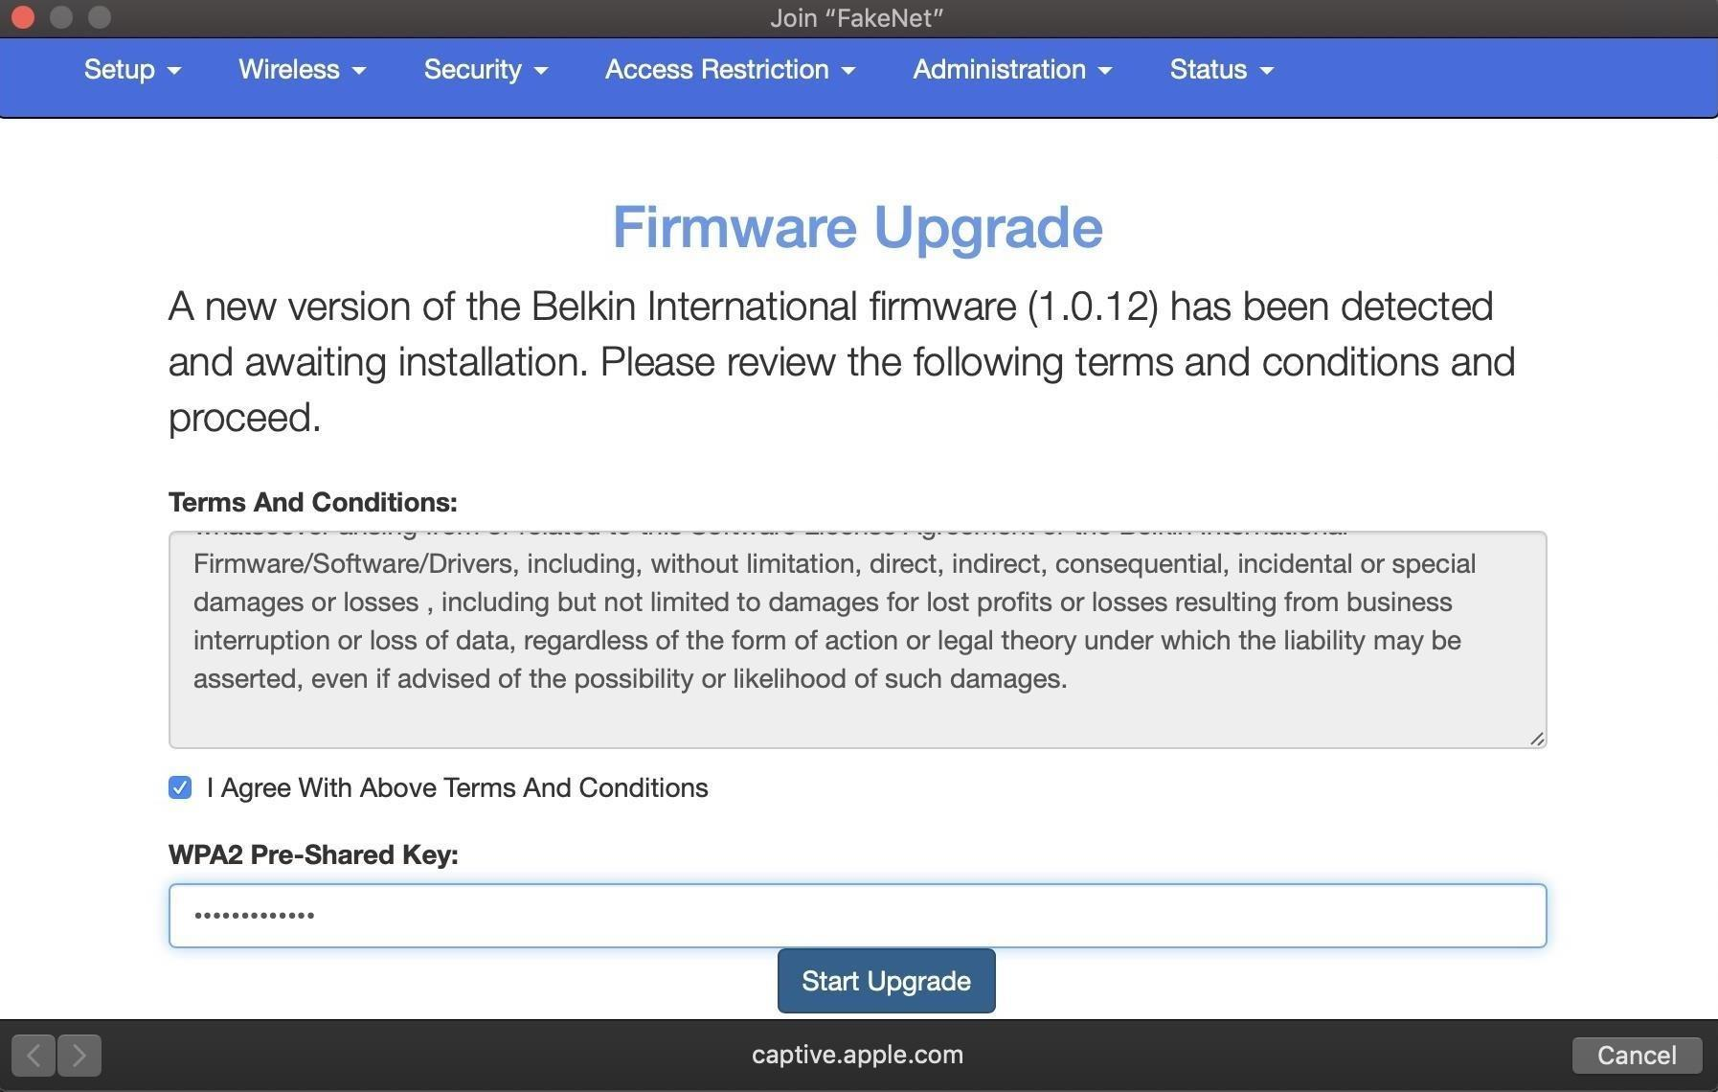
What does the victim see?

Slide 24
WPS Setup Pin Attacks
These attacks are based on a feature that allows you to connect with a PIN to your router if you forget your password.
Many routers use a bad random seed for this that makes it possible to crack in 15 seconds.
Only about 40% of routers are vulnerable, only about 50% of routers have this enabled.

Slide 25
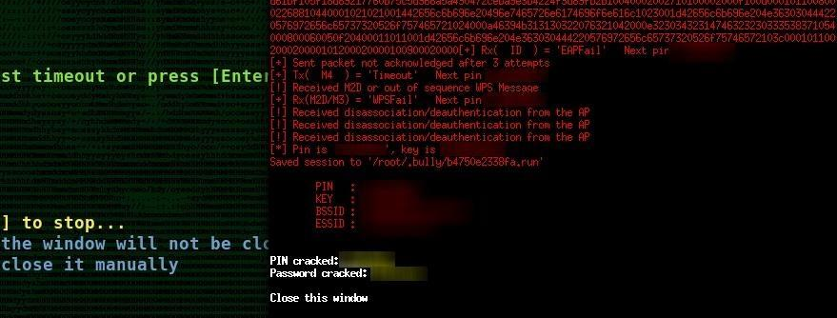
WPS Attacks don’t always work but are powerful
This doesn’t work if WPS is disabled or the wrong version, but if it does, you get backdoor access to the router even if they change the password.

Slide 26
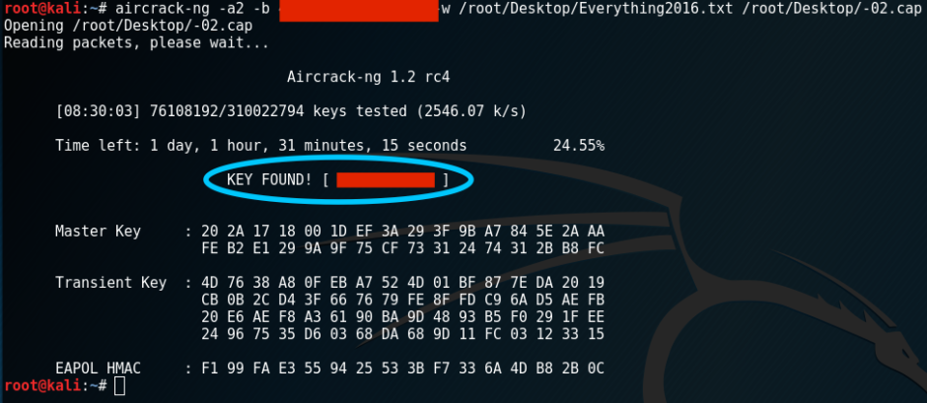
WPA Handshake Brute Force Attacks!
This is the tried and true method of getting a modern Wi-Fi password.
Even though we can’t grab a password out of the air, we can use a computer’s processing power to figure it out. We’ll do a demo of this today!

Slide 27
What makes modern WPA2 vulnerable to this?
If you capture the handshake that occurs when a device joins a Wi-Fi network, you can use that captured information to crack the password.
Anyone can kick a client off of a Wi-Fi network, even if you don’t know the password. We will learn to do this with our microcontrollers today.
That means, provided at least one device is connected to a Wi-Fi network, anyone can kick that device off the network and capture the handshake when the device reconnects.

Slide 28
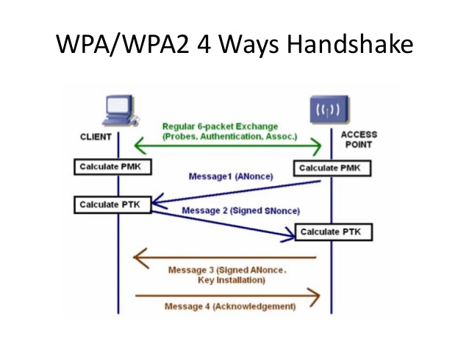
How do we capture a handshake?
To capture a handshake, we can either wait for a device to connect to the network, or we can kick a device off and record the handshake when it reconnects.
We need to be on the same channel to capture the handshake as well

Slide 29
What do we do with a handshake?
A handshake is a hashed version of the Wi-Fi password. A hash takes the password and converts it into a unique number via a fixed formula.
If we take a password guess and run it with the same formula, it will come out to the same number as the handshake if the password is correct.
A computer can convert several thousand password guesses per second into a hash, and compare them to see if it matches

Slide 30
WPA Cracking Workflow
Identify the network you are attacking, switch your wireless network adapter to capture on that channel - airmon-ng tool
Record Wi-Fi traffic on that channel until you capture a handshake and save it - airodump-ng tool or Wireshark
Load the file of captured traffic containing the handshake into a cracking program - aircrack-ng tool
Load a big list of password guesses
Let the computer guess passwords until it succeeds or runs out of passwords

Slide 31
What do you need to crack a password?
A wireless network adapter that can “listen” in monitor mode. Usually, Wi-Fi is like a one on one conversation.
Some network cards can be switched to “monitor mode” which allows them to listen to traffic that wasn’t meant for them.
Yours may work, but we be can use a Raspberry Pi or wireless network adapter from Alfa or Panda wireless.
We can use our microcontroller to spoof, attack, and even sniff packets, but it can’t capture handshakes. On a MacOS system, we can capture and crack handshakes generated by our microcontroller without another card.

Slide 32
Questions?
Next, we’ll get into where microcontrollers fit into the picture.
We’ll go over how to connect to your D1 Mini, use the web interface, connect to the serial interface, and what attacks are possible.
After that, we’ll start attacking reactive targets!

Slide 33
Technical section overview
Core skills review:
Denial of service/deauthing
Creating fake networks to unmask devices
Objectives:
Attack a single device on a network
Create a cloned fake network

Slide 34
How Did the ESP8266 Learn to Hack?
Stefan Kremser, a computer science student in Germany also known as Spacehuhn, wanted to send Wi-Fi packets from scratch.
He found old SDK for programming the ESP to send any random packets
He wrote deauth packets manually to send out using packet.freedom method, allowing him to “spoof” packets
This allows him to send messages to any connected device pretending to be from the router telling it to get off the network
He can also send packets that create the appearance of a Wi-Fi access point, or a device looking for an access point

Slide 35
Let’s Get Connected!
We can connect using:
Serial, with screen or picocom
Arduino IDE
Over Wi-Fi in a browser, with the web interface by going to 192.168.4.1
Right now there are 25-30 devices all with the same name, so we can’t use the web interface until we change the name. We’ll set that up by connecting over serial first.

Slide 36
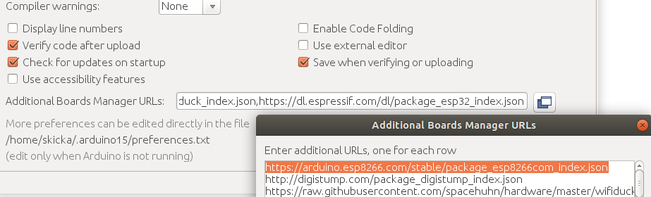
Recommended: Arduino IDE
Arduino IDE is easiest to connect to your board with.
Download Arduino IDE, go to Preferences, and then past this JSON link into the additional board manager URL:
https://arduino.esp8266.com/stable/package_esp8266com_index.json

Slide 37
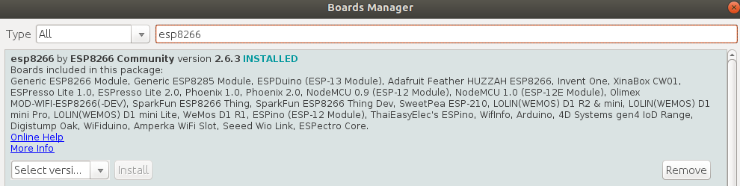
Install the ESP8266 Boards in the Board Manager
Under Tools, Board, and Board Manager, type “ESP8266” into the search menu.
Install the esp8266 by ESP8266 Community boards by clicking the install button.

Slide 38
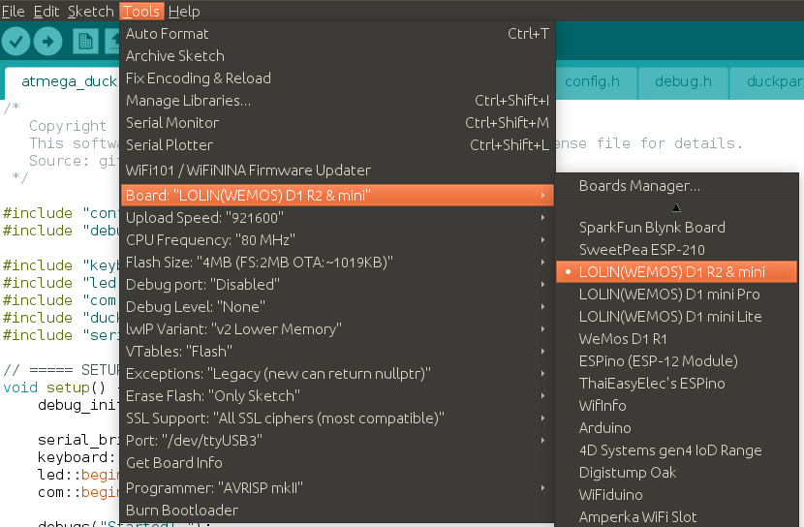
Plug in Your Board
Plug in your board and, under ESP8266 boards, select the “LOLIN(WEMOS) D1 R2 & mini” board.
Look at the port, is it auto-selected? If so, you’re ready to connect

Slide 39
What If Your Port Isn’t Auto-Selected?
You’ll have to select it manually.
In MacOS, open terminal and type: ls /dev/cu*
In Linux, open a terminal window and type: dmesg
Look for “ttyUSB” and then a number, like ttyUSB3
In Windows, look in your device manager under your COM port, for something like COM1
Once you identify your port, we can connect to our board!

Slide 40
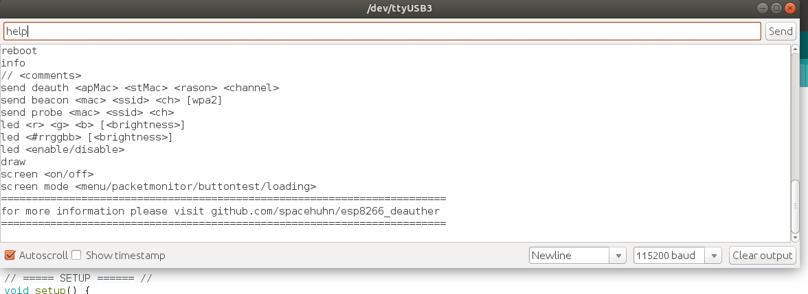
Connect in Arduino IDE
With the port and board set correctly, press CTRL + SHIFT + M to open a serial monitor, or go to Tools and click Serial Monitor. When it opens, type help and click “Send”

Slide 41
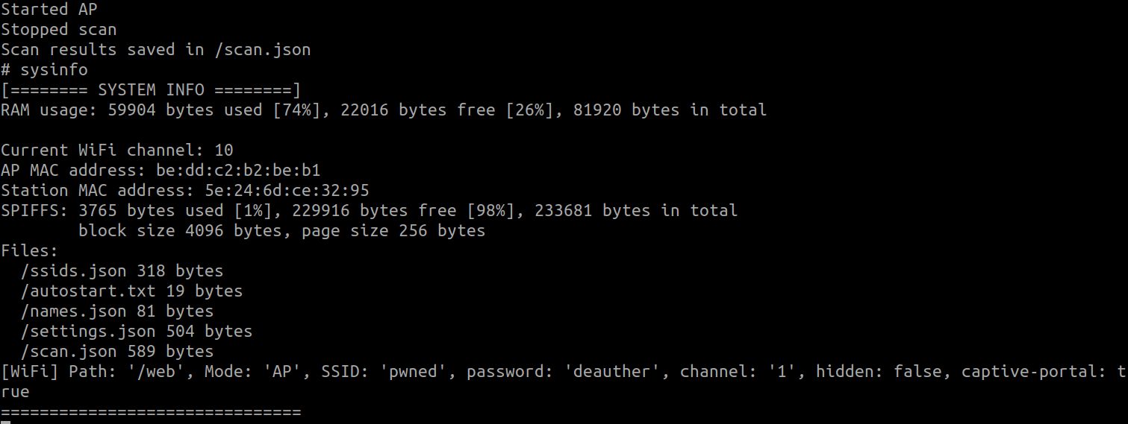
Connecting Over Serial
With our port being ttyUSB3, we can connect in a terminal window with the following command (type help if you don’t see anything):
screen /dev/ttyUSB3 115200

Slide 42
Run Your First Command
Once you’re connected over serial via Arduino or Screen, run the following commands:
Chicken
Info
Help
Scan
Show aps
Show stations

Slide 43
Caught Up?
Raise your hand if you need help connecting, we’ll continue when everyone is connected to their board.

Slide 44
Set The Wi-Fi Access Point To Your Hackername
Pick a hacker name and set your board to use that name for it’s Wi-Fi network
Type this command, but pick a number from 1 to 11 for the channel number (-ch) and replace hackername with your hacker name:
startap -s hackername -pswd deauther -ch 6
After a minute, look for your device on the network. You can connect with the password deauther

Slide 45
Wireless AP Interface:
Enable: startap [-p <path][-s <ssid>] [-pswd <password>] [-ch <channel>] [-h] [-cp]
Disable: stopap
Now, you should be able to find and log in to the web interface. After connecting, go to 192.168.4.1 in a browser window.

Slide 46
The Wi-Fi Hacking Workflow
Hunting for networks (APs) and Wi-Fi devices (stations)
First, we use the scan command to find the channel the target AP broadcasting is on. Then, we scan again for all stations on that channel.
scan [<all/aps/stations/wifi>] [-t <time>] [-c <continue-time>] [-ch <channel>]
Scan for all AP’s on channel 6: scan aps -ch 6
Scan for all clients on channel 11: scan stations -t 20s -ch 11
Draw packet graph: draw

Slide 47
Find The Target in Scan Results
Show detected stations/AP’s: show [<all/aps/stations/names/ssids>]
Show all AP’s to see all networks in an area: show aps
Show all client devices with: show stations
We’ll need to select the one (or ones) to attack from this list

Slide 48
Selecting the Target From Scan:
Select a target: select [<all/aps/stations/names>] [<id>]
Mistake? Deselect a target: deselect [<all/aps/stations/names>] [<id>]
Select all AP’s: select aps
Select all stations: select stations
Select AP number 5 from our list of scanned APs: select aps 5
Select client 3 from our list of detected clients: select stations 3
Show targets selected: show selected

Slide 49
What Does This Mean?
If we select an AP and attack it, we attack the entire network
If we select a station, we attack only that and leave the rest of the network alone
In our examples, we’ll be focusing on selection stations.
Please to not deauth all, or attack networks outside the scope of our targets?

Slide 50
Step 6: Attack a target
Attack command: attack [beacon] [deauth] [deauthall] [probe] [nooutput] [-t <timeout>]
Attack all selected targets: attack -d
Attack all networks in range: attack -da
Check status of attack: attack status [on/off]
Stop an attack in progress: stop -a

Slide 51
Create Fake Networks:
Start our beacon attack: attack -b
Stop attack: stop -a
Check our list of ssids: show ssids
Remove command: remove <ap/station/names/ssids> [all]
Remove default SSIDs: remove ssids all
Add AP #0 from our scan, cloned 20 times: add ssid -ap 0 -cl 20
Add custom fake network (must escape spaces): add ssid “Dokdo\ Proud\ to\ Island” [-wpa2] -cl 20 [-f]

Slide 52
Advanced Scripting: Compound Commands
Can use DELAY and :: to combine commands.
scan for 60 seconds on channel 6 and show all stations after a 65-second delay:
scan wifi -t 60s -ch 6;;DELAY 65s;;show stations

Slide 53

How Can We Use This To Crack Wi-Fi?
In Wireshark, we can listen in on a channel a target network is broadcasting on
With the deauther, we blast someone off the network
When the reconnect, we record the handshake and crack it from a wordlist

Slide 54
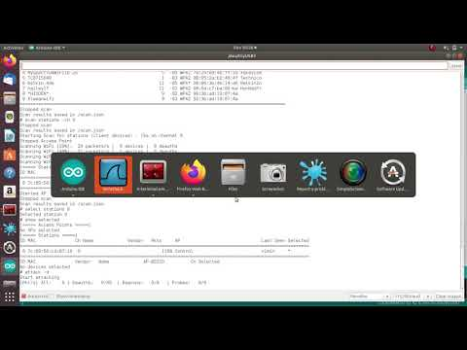
What Does That Look Like?

Slide 55
Game: Wi-Fi Lottery
For our Wi-Fi hacking challenge today, we’ll be playing the Wi-Fi hacking lottery!
We’ll be dividing into 5 teams, and each team will get a number.
To win, your team must be the fastest to kick only the device with your number off the network while leaving the other numbers connected.
Each team will get a turn to record how long it takes to set their target red while leaving the other targets green.
The team with the shortest time will be the winner!

Slide 56
How To Win:
Scan for the access point the targets are connected to (“Control”)
Scan for devices (stations) on the same channel as “Control”
Identify all the targets connected to Control, select one
Kick off the target, watch which target turns red
Repeat until the target with your number turns red
Your time stops when all targets are green except your team’s number

Slide 57
Thank You!
Want to support us? Join the Cyber Weapons Lab Meetup group and add me on Twitter @KodyKinzie
You can also buy:
Deauther Board Kit - $10
Cyber Weapons Lab LA Sticker - $6
Wi-Fi Reactive Target Kit - $20
Check out our upcoming workshops!

